Slide 1
JOINT AUTHORITIES FOR RULEMAKING OF UNMANNED SYSTEMS
Workshop on Drones: outreach to industry
Eric Sivel
JARUS Chairperson
Cologne, 20 June 2016

Slide 2
AGENDA
General Presentation
Ongoing activities
JARUS Structure
Recent key deliverables:
SORA
ATM Conops
Way Forward

Slide 3
GENERAL: JARUS PURPOSE
JARUS is a group of experts from its NAA members, including regional authorities originally established in 2007.
JARUS members collaborate to recommend technical, safety, and operational requirements for the certification and safe integration of UAS into airspace and at aerodromes

Slide 4
GENERAL: JARUS MEMBERS
New Member Countries in 2016: Costa Rica, Croatia, Kenya, Republic of Serbia
EASA Member States
Austria
Belgium
Croatia
Czech Republic
Denmark
Estonia
Finland
France
Germany
Greece
Ireland
Italy
Latvia
Luxembourg
Malta
Netherlands
Norway
Poland
Romania
Spain
Sweden
Switzerland
United Kingdom
Rest of the World
Australia
Brazil
Canada
China
Colombia
Georgia
India
Israel
Jamaica
Japan
Kenya
Malaysia
Qatar
Republic of Korea
Republic of Macedonia
Republic of Serbia
Russia
Singapore
South Africa
Trinidad & Tobago
Turkey
United Arab Emirates
United States of America
International Organisation
EASA
Eurocontrol
EASA Member States not members yet
Bulgaria, Cyprus, Hungary, Iceland, Liechtenstein, Lithuania, Portugal, Slovakia, Slovenia

Slide 5
GENERAL: STAKEHOLDER CONSULTATION BODY (SCB)
At the end of 2015, the SCB representing the Industry
was established representing:
Aircraft manufacturers (AIA, ASD)
Unmanned system Industry (AUVSI, UVSI, small UAS Coalition)
ANSP (CANSO, COCESNA)
Standardization Bodies (EUROCAE, RTCA and ASTM)
Operators and pilots IAOPA, IBAC, IFALPA, IFATCA, IATA
Representatives from these organisations joined the JARUS Plenary Meeting, which took place in Madrid from 11-15 April 2016.
Experts from the SCB have been invited to contribute to the JARUS Working Groups.

Slide 6
GENERAL: JARUS DELIVERABLES
JARUS deliverables/products are recommended certification specifications and operational provisions made available to interested parties such as ICAO, NAAs and regional authorities for their consideration and use.
JARUS does NOT develop law or mandatory standards.
NAAs and regional authorities decide how to use harmonised provisions from JARUS.

Slide 7
JARUS ONGOING ACTIVITIES
JARUS is contributing to the development of the RPAS regulatory framework, in the domains where other organisations (e.g. ICAO) have not been active yet, to promote a harmonised approach.
Current ongoing JARUS activities will be based on initial framework priciples:
UAS Operational Categorisation (i.e. open, specific, and certified) – Higher level (2014/EASA/2016)
Risk assessments for UAV operations (Specific operational risk assessment – SORA (2017)
ATM concept for different operations – Higher level (2016)
DAA concept for visual line of sight, extended, and beyond VLS – Derived (2016)
Command and control concept for different operations – Derived (2016)
All key deliverables will be available to the RPAS Community early in 2017
Once JARUS reaches consensus on the concepts above, operational, technical, and certification specifications will be derived from them.

Slide 8
OVERVIEW JARUS DELIVERABLES (http://jarus-rpas.org)
WG | Title | Description | Status
WG3 | Certification Spec for LURS | Certification Specification for Light Unmanned Rotorcraft Systems | Published 30/10/2013
WG5 | RPAS C2 Link RCP | Guidance material to explain the concept of C2 link RCP and identify the requirements applicable to the provision of C2 communications. | Published 10/10/2014
WG1 | FCL Recommendations | The document aims at providing recommendations concerning uniform personnel licensing and competencies in the operation of RPAS | Published 09/09/2015
WG6 | AMC RPAS 1309 (package) | Document developed as an integral part of a type-certification process. It is a means of compliance to a 1309 airworthiness requirement. | Published 01/11/2015
WG3 | CS-LUAS | It provides recommendations for States to use for their own national legislation, concerning Certification Specification for Light Unmanned Aircraft Systems. | Internal Consultation
WG6 | SORA | Specific Operations Risk Assessment. Recommends a risk assessment methodology to establish a sufficient level of confidence that a specific operation can be conducted safely. | Internal Consultation
WG5 | CPDLC | The Controller Pilot Data Link Communications document is meant to summarize the most relevant information about CPDLC and the supported ATS services, and to associate them with RPAS operations. | To be soon published
WG4 | Detect and Avoid | This document describes the methods to derive design objectives for DAA systems based on airspace requirements. | Internal Consultation
WG7 | RPAS Operational Categorization | Categorization scheme that describes the level of regulatory involvement for the varying types of UAS and UAS operations. | Internal Consultation
WG1 | FCL GM | Guidance material to the JARUS FCL Recommendation | Internal Consultation

Slide 9
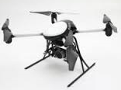
WORKING GROUPS STRUCTURE
CONOPS
FLIGHT CREW LICENSING (FCL)
WG 1
OPERATIONS (OPS)
SAFETY & RISK MANAGEMENT
WG 6
WG 2
WG 7
WG 5
WG 3
WG 4
AIRWORTHINESS
COMMAND AND CONTROL
DETECT & AVOID

Slide 10
WORKING GROUPS (WGs) – 1/2
WG 1 – Flight Crew Licensing (FCL)
Requirements for licensing and competencies in RPAS activities;
Pilot licensing and training
WG 2 – Operations
Operational requirements for access to airspace
Organizational requirements for RPAS operations
WG 3 – Airworthiness
UAS certification & airworthiness provisions/specifications for:
Rotary wing, Light Unmanned Rotocraft System (CS-LURS)
Fixed wing, Light Unmanned Aeroplane System (CS-LUAS)
Very light UAS (VL lUAS)
Airships, free/tethered balloons

Slide 11
WORKING GROUPS (WGs) – 2/2
WG 4 – Detect and Avoid
Define performance provisions (operational/technical)
Establish safety objectives for the risk of collisions
WG 5 – Command, Control & Communications
Establish performance provisions (operational & technical) for C3
WG 6 – Safety and Risk Management
Define top level RPAS airworthiness, system safety objectives and guidance material (known as AMC RPAS.1309)
Establish UAS recommendations & conclusions on UAS failure classifications in terms of severity definition and probability requirements.
Create a methodology to assess the risks of «specific» RPAS operations and evaluate relevant mitigations
WG 7 – Concept of Operations (CONOPS)
Develop a classification scheme for RPAS
Considerations for RPS Certification, C2 & signal relay and launch and recovery equipment

Slide 12
Specific Operation Risk Assessment (SORA)

Slide 13
Specific Operation Risk Assessment (SORA)
Enables the Specific operations
Accounts for type, scale, complexity of the activity, third parties at risk
Holistic and not atomistic
Focus on objectives rather than means
Allows for scenario determination
Allows for continuous improvements (iteration loops)
Developed with stakeholders

Slide 14
Specific Operation Risk Assessment (SORA)
Recommended level of rigor
Open
Specific
Certified
-Operational
-Design
-Production
SAIL VI
SAIL IV
SAIL V
SAIL III
SAIL II
SAIL I
Intrinsic risk of UAS operation
Notes:
ROC, bucket for scenarios

Slide 15
SORA
Specific Assurance and Integrity Level (SAIL) evaluation
SORA Output
Objectives to be met and their (level of robustness):
SAIL I: 18 (Low)
SAIL II: 19 (Low), 6 (Med)
SAIL III: 11 (Low), 15 (Med), 6 (High)
SAIL IV: 3 (Low), 19 (Med), 12 (High)
SAIL V: 6 (Med), 28 (High)
SAIL VI: 35 (High)
SORA Input
Concept of Operations
Information on:
Operator
Intended operation
UAS description
Remote crew
Ground Risk Class
Air Risk Class
Lethality
SAIL determination
SORA Annexes
Feedback loop for «continuous improvements»
Notes:
If input is a generic scenario, output is a generic SAIL. Guidance material for each SAIL.
The entire process of SAIL determination is completed in a matter of minutes. The effort for the verification of compliance to objectives is a function of the SAIL.

Slide 16
Specific Operation Risk Assessment (SORA)
The SORA is in internal JARUS consultation (via JARUS website). Comments from JARUS members and te SCB are welcome!
A link with industry standardization bodies will be established to develop guidance material

Slide 17
RPAS ATM Conops

Slide 18
RPAS ATM CONOPS
Is flexible: it is independent from continuously evolving scenarios
Is generic: it addresses any RPAS category or technology
Is operationally oriented: it provides an operational ATM perspective based on areas of operations
Is opening the door to standardized contingency procedures
Is based on the following logic
Area of operation
Class of traffic
Class of airspace
Category of RPAS (from EASA CONOPS)
NB: This CONOPS is a draft, it is as of today not validated.

Slide 19
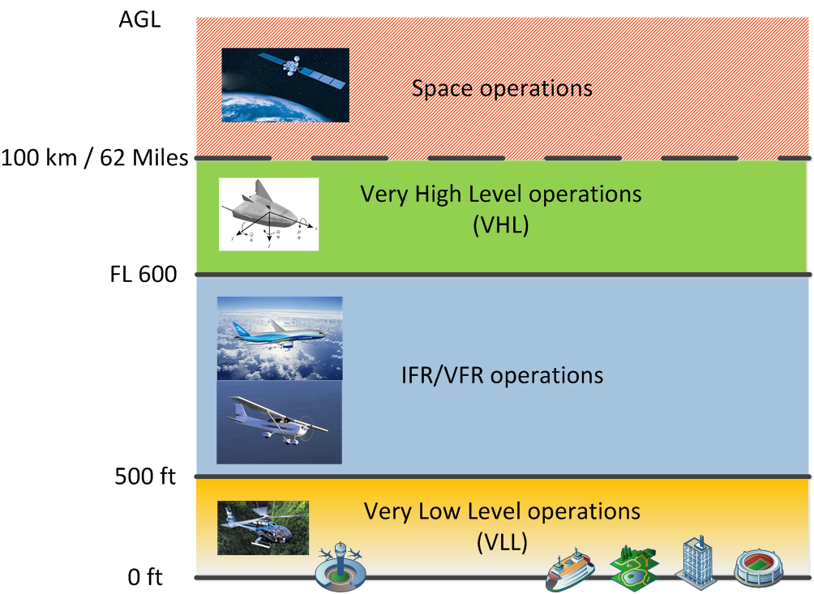
Areas of operations as used in this CONOPS

Slide 20
What is a “Class of RPAS traffic” ?
As RPAS are very difficult to categorise due to the large variety of shapes, sizes, performance and operations; different traffic classes have been developed to support the management of large numbers of RPAS operations.
A “Class of RPAS traffic” is a set of flying rules, operational procedures and system capabilities applicable to the RPAS and to the operator when operating the RPAS in a portion of the airspace.
A Class of RPAS traffic is supported by CNS services external to the operator.

Slide 21
WAY FORWARD
Increased JARUS participation already anticipated from both NAAs and industry
Increased coordination facilitated by new organization (e.g. Secretariat, regional offices)
Valuable contributions to ICAO efforts from members/advisors involved in JARUS & ICAO
Continuing need for increased membership and resource commitments from ALL

Slide 22
Questions
contact@jarus-rpas.org
+32 2 729 3629
+32 2 8013 902
http://jarus-rpas.org/

